Slide 1


SOL NOVA ENERGY PVT LTD
TEAM MEMBERS:
  AMAN SINGH – MBA25056
  KSHITIJ BARANWAL – MBA25243
  ANISH DEY – MBA25058
  PRATEEK SAGAR – MBA25078
  ROHIT GHOSH – MBA25084
  ADHIRAJ SINGH – MBA25053

Slide 2

RATIONALE AND CLASSIFICATION
  Direct Alignment with SDG 13: Climate Action: Solar energy is a direct substitute for fossil fuels, crucial for reducing greenhouse gas emissions.
  Addressing India's Urgency: India is highly vulnerable to climate hazards like droughts and floods, making a clean energy transition essential.
  Strong Business Potential: The growing demand for solar solutions offers both profitability and significant environmental impact.
  Sector: Energy
  Sub-sector: Renewable Energy
  Category: Solar-Powered Energy
  NIC Code: 35105 (Electricity generation from solar photovoltaic (PV) and solar thermal sources)

Slide 3
SIZE AND SCOPE
  Installed Capacity (India 2024): ~72 GW
  Target by 2030: 280 GW
  Applications: Grid plants, rooftop systems, solar pumps, rural microgrids
  Employment Potential: 1M+ green jobs projected
  Global Solar Market: $253.7B (2023) → $436.4B (2032), CAGR ~6%

Slide 4
GROWTH, GDP AND LIFE CYCLE
  Renewables = ~30% of India’s installed capacity (2023)
  Solar = ~54% of India’s renewable capacity (~67 GW)
  Global solar = ~80% of new renewable capacity (2024)
  Contribution: Solar + Wind = ~7% of global electricity (2024)
  Industry Life Cycle Stage: Growing → Shaking Out phase

Slide 5
COMPETITIVE LANDSCAPE AND PESTEL
  Global Players: Jinko Solar, JA Solar, Trina Solar (China dominates ~80% supply chain)
  Indian Player: Vikram Solar (4.5 GW/year capacity)
  PESTEL:
    Political: 500 GW renewable target by 2030, subsidies
    Economic: Solar PV costs ↓ 80% since 2010
    Social: 250K jobs (2023) → 1M by 2025
    Technological: 20–22% panel efficiency, battery costs ↓ 89%
    Environmental: 37M tons CO₂ avoided (2021)
    Legal: Supportive policies, occasional tariff/payment delays

Slide 6
UN SDGS OVERVIEW
  Adopted in 2015 by UN
  17 universal goals: poverty, planet protection, prosperity
  Integrated approach (social, economic, environmental)

Slide 7
CHOSEN GOAL – SDG 13 (CLIMATE ACTION)
  Mission: “Take urgent action to combat climate change and its impacts”
  Rationale:
    Directly reduces GHG emissions
    India vulnerable to climate change effects
    Aligns with Paris Agreement commitments
    Growing business and impact opportunity

Slide 8
SDG 13 – TARGETS
  13.1: Strengthen resilience to climate hazards
  13.2: Integrate climate change in policies & planning
  13.3: Education and awareness on climate change
  13.a: Climate finance commitments
  13.b: Build capacity in developing countries

Slide 9
CONTRIBUTION PLAN
  Target 13.2:
    Affordable rooftop kits for rural households
    Solar in public buildings (state agency partnerships)
    Advocate for solar policy incentives
  Target 13.3:
    Launch “Solar for Climate” awareness campaign
    Train youth as certified solar technicians
    Build carbon-tracking mobile app

Slide 10
COMPANY OVERVIEW
  Name: SolNova Energy Pvt. Ltd.
  Founded: 2022 | HQ: Pune, India
  Business Scope:
    Solar manufacturing & installation
    Microgrid solutions for rural areas
    Carbon footprint consultancy
  Goal: Make solar power affordable, accessible, reliable

Slide 11
LOGO ANALYSIS
  Design: Golden sun over teal horizon, infinity symbol rays
  Meaning: Endless renewable energy, optimism, sustainability
  Color Palette:
    Sunburst Yellow → energy, warmth
    Ocean Teal → water, calm, sustainability
    Deep Charcoal → grounded, professional
    Black → sharp, modern contrast

Slide 12
MISSION, VISION, VALUES
  Mission: Empower communities with clean, affordable solar energy
  Vision: Make solar India’s primary energy source; carbon-neutral by 2040
  Core Values:
    Sustainability
    Innovation
    Accessibility
    Integrity
    Collaboration

Slide 13
STAKEHOLDERS
  Internal:
    Founders
    Board
    Engineers, Technicians, Sales/Admin, R&D, Operations
    Finance
    Legal
  External:
    Customers
    Suppliers,
    Government
    NGOs
    Investors
    Local communities, Educational institutions

Slide 14
INTERNAL STAKEHOLDERS AND RATIONALE
  Targeted Stakeholders:
    Founders & Board of Directors
    Employees (Engineers, Technicians, Sales, Admin)
    R&D Department
    Operations Team ( Finance and Legal)
  Rationale for Targeting:
    Engaging our internal teams is crucial because they are the driving force behind SolNova's mission. Their understanding and commitment to SDG 13 are essential for integrating climate action into daily operations, from manufacturing to installation and consultancy.

Slide 15
STRATEGIES
  Strategy:
    Monthly "SDG 13 Spotlight" Newsletter: An internal newsletter to highlight company achievements, new policies, and individual employee contributions related to SDG 13.
    "Green Innovator" Recognition Program: A program to recognize employees who propose and implement innovative, sustainable solutions.
    Mandatory SDG 13 Training: Integrate climate action and sustainability training into the onboarding process for all new employees.
  Rationale for Strategy:
    Monthly Newsletter ensures consistent information reaches all employees.
    "Green Innovator" Recognition Program incentivizes innovation and a proactive approach to sustainability, aligning with a core company value.
    Mandatory Training ensures every employee understands their role in contributing to SDG 13.

Slide 16
PROTOTYPE – RECOGNITION PROGRAM
  Description:
    A prototype of an internal program designed to encourage and reward innovation in sustainability.
  Prototype design:
    Image: A digital badge or certificate titled "SolNova Green Innovator" with the company's logo.
    Text: "Nominate a Colleague Who Has Made a Positive Environmental Impact! Winners will be featured in our monthly newsletter and receive a certificate and a bonus.
    Benefit: This program directly supports the company's core value of Innovation and fosters a sense of ownership among employees for the company's climate action goals.

Slide 17
CHANNELS
  Channels:
    Email & Internal Newsletter: For company-wide updates, policy changes, and the "SDG 13 Spotlight".
    Internal Social Platform (e.g., Slack/Teams): For quick communication, team-based collaboration, and sharing short-form success stories.
    Monthly Town Hall Meetings: To provide updates from founders and the board and to celebrate the "Green Innovator" of the month in person.
  Rationale:
    Rationale for Email & Internal Newsletter: For company-wide updates, policy changes, and the "SDG 13 Spotlight" newsletter.
    Rationale for Internal Social Platform (e.g., Slack/Teams): For quick communication, team-based collaboration, and sharing short-form success stories.
    Rationale for Monthly Town Hall Meetings: To deliver mandatory training on climate action and its connection to the company's work.

Slide 18
EXTERNAL STAKEHOLDERS & RATIONALE
  Targeted Stakeholders:
    Customers (households, businesses, rural communities)
    Government & Regulatory Bodies
    Investors
    NGOs & Environmental Organizations
  Rationale for Targeting:
    These stakeholders are crucial for scaling SolNova's operations and achieving its vision. Engaging them directly builds brand loyalty, secures financial support, and helps influence policy for accelerated solar adoption.

Slide 19
STRATEGIES
  Strategy:
    "My Solar Impact" Mobile App: An application allowing customers to track their carbon footprint reduction, energy savings, and direct contribution to SDG 13.
    Policy Advocacy White Papers: Publish research and white papers for government agencies to advocate for supportive solar policies.
    Partnership with NGOs: Collaborate on community awareness campaigns and training programs to certify local youth as solar technicians.
  Rationale for Strategy:
    Rationale for "My Solar Impact" Mobile App: The app helps us make solar power accessible and reliable, contributing directly to SDG 13.
    Rationale for Policy Advocacy White Papers: This formal approach positions SolNova as a thought leader and helps us advocate for policy incentives.
    Rationale for Partnership with NGOs: This amplifies our reach and contributes to SDG 13 by promoting education and awareness.

Slide 20
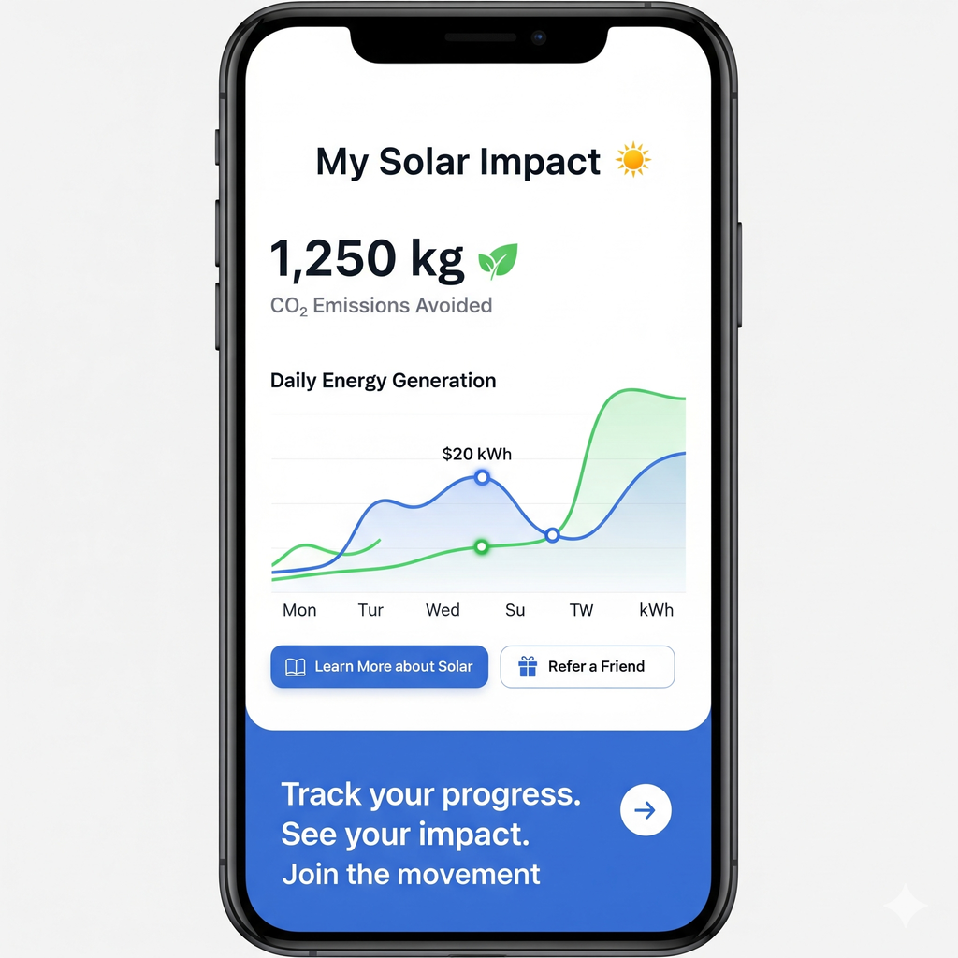
PROTOTYPE – MOBILE APP

Slide 21
CHANNELS
  Channels:
    Public Relations & Media: To announce major projects, partnerships with NGOs, and policy recommendations.
    Social Media (LinkedIn, Twitter): For investor relations, policy updates, and engaging with NGOs and the broader public.
    Digital Platforms & Mobile App: To communicate directly with customers and empower them to track their contribution to SDG 13.
  Rationale:
    Rationale for Public Relations & Media: To announce major projects, partnerships, and policy recommendations.
    Rationale for Social Media (LinkedIn, Twitter): For investor relations, policy updates, and engaging with NGOs and the broader public.
    Rationale for Digital Platforms & Mobile App: To communicate directly with customers and empower them to track their contribution to SDG 13.

Slide 22
UNIFIED APPROACH
  Strategy:
    Develop a unified, single campaign to be used for both internal and external audiences, creating a cohesive brand identity and a shared sense of purpose.
  Rationale for Strategy:
    A common strategy reinforces the idea that the company's mission is central to its identity, not just a marketing effort. It shows that employees, customers, and investors are all part of the same mission to combat climate change and its impacts. This aligns with the core value of Collaboration.

Slide 23
STRATEGIES
  Strategy:
    "Solar for Climate" Campaign: A unified campaign with a consistent message promoted across both internal and external channels. The campaign will use a cohesive visual identity and key messages focusing on the direct link between solar power and climate action.
    Joint Recognition Event: Host an annual event that brings together employees, investors, and community partners to celebrate achievements in climate action.
    Storytelling Initiative: Collect and share stories from employees and customers about how SolNova's work is positively impacting their lives and the environment.
  Rationale for Strategy:
    Rationale for "Solar for Climate" Campaign: A consistent brand message builds credibility and reinforces the company's commitment to SDG 13 for all stakeholders.
    Rationale for Joint Recognition Event: This fosters a sense of community and shared purpose, aligning with our value of Collaboration.
    Rationale for Storytelling Initiative: Humanizing the company's work through personal narratives connects with both audiences and makes climate action relatable

Slide 24

PROTOTYPE – CAMPAIGN VISUAL

Slide 25
CHANNELS
  Social Media (LinkedIn, Facebook, Instagram):
    A single social media presence on platforms like LinkedIn, Facebook, and Instagram to share the "Solar for Climate" campaign, employee success stories, and customer testimonials.
  Website & Annual Report (progress updates on SDG 13):
    The website and annual report will feature dedicated sections on the company's progress towards SDG 13, highlighting both internal and external contributions.
  Shared Events (SolNova Impact Gala):
    The annual "SolNova Impact Gala" which will be attended by both internal teams and external partners, serving as a unifying platform.

Slide 26
CONTRIBUTION
  Aman Singh – [insert contribution]
  Kshitij Baranwal – [insert contribution]
  Anish Dey – [insert contribution]
  Prateek Sagar – [insert contribution]
  Rohit Ghosh – [insert contribution]
  Adhiraj Singh – [insert contribution]

